Slide 1
ZYNQ Design Flow
Notes:
WEEK 3

Slide 2
Required Reading
The ZYNQ Book
Chapter 3: Designing with Zynq
(“How do I work with it?”)
Xcell Journal
Xilinx Unveils Vivado Design Suite for the Next
Decade of ‘All Programmable’ Devices,
by Mike Santarini, issue 79, Q2, 2012

Slide 3
Vivado Design Suite
4 years of development and 1 year of beta testing
first version released in Summer 2012
scalable data model, supporting designs with
up to 100 million ASIC gate equivalents (GEs)
based on industry standards, such as
  AMBA AXI4 interconnect
  IP-XACT IP packaging metadata
  Tool Command Language (Tcl)
  Synopsys Design Constraints (SDC)

Slide 4
Productivity Gains
Synthesis tool 3x faster than Xilinx XST
Substantial improvement in runtime and
maximum design size compared to Xilinx ISE
Vivado Simulator 3x faster than Isim
Much better visibility into key design metrics, such
as timing, power, resource utilization, and routing congestion much earlier during the design process
Estimates becomes progressively more accurate

Slide 5
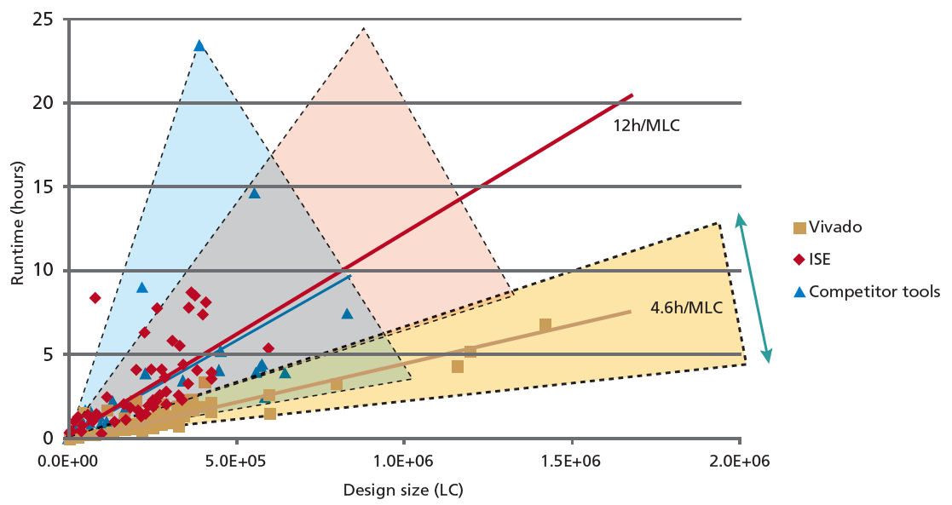
Vivado vs. ISE vs. Competing Tools
Source: Xcell, no. 79, 2012

Slide 6
Design Entry Methods
VHDL, Verilog
System Verilog
C, C++
System C
Matlab
Simulink
Notes:
System c mô tả phần cứng
Matlab, simulink được sử dụng để thiết kế mô hình hóa bậc cao
Khác nhau giữa ngôn ngữ mô tả phần cứng và ngôn ngữ mô tả phần mềm: Phần mềm thao tác trực tiếp trên các thanh ghi bộ nhớ chứa data. Phần cứng thao tác trên các tín hiệu (signal)

Slide 7
Multidimensional Analytical Placer
ISE:
One-dimensional, timing-driven place-and-route algorithms
Simulated annealing algorithms that determine
randomly where the tool should place logic cells
Does adequate job for FPGAs below 1 million GEs
Vivado:
Modern multidimensional analytic placement algorithm
Deterministically finds a solution that primarily minimizes: timing, congestion, and wire length
Better results, fewer iterations
Efficient up to 100 million GEs
Notes:
Place and route: đi dây, xem xét chiều dài dây dẫn, timing, nghẽn

Slide 8
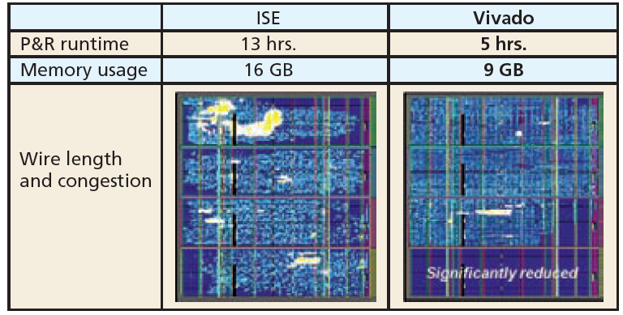
Vivado’s Multidimensional Optimization
Source: Xcell, no. 79, 2012

Slide 9
Hierachical Chip Planning
& Advantages of Standards
ability to partition the design for processing by synthesis, implementation and verification
divide-and-conquer team approach to big projects
design preservation feature enabling repeatable timing results
access to state of the art third-party EDA tools for tasks such as
    constraint generation
    formal verification
    static timing analysis

Slide 10
Power Optimization and Analysis
capable of analyzing design logic and removing unnecessary switching activity
advanced clock gating techniques
up to 30% reduction in dynamic power
power estimates at every stage of the design flow

Slide 11
Flow Automation, Not Flow Dictation
GUI-based push-button flow
GUI-based step-by-step analysis at each design stage
Command line
Batch

Slide 12
IP Packager, Integrator, and
Extensible IP Catalog
any part of the design (including the entire design) can be
turned into a reusable core at any level of the design flow:
    RTL
    netlist
    placed netlist
    placed-and-routed netlist
IP-XACT descriptions easy to integrate into future designs
IP Packager specifies the IP data using XML file
Extensible IP Catalog allows users to build their own standard repositories from IP they’ve created, licensed from Xilinx, or licensed from third-party vendors

Slide 13
High-Level Synthesis
extensive evaluation of commercial tools for
Electronic System Level (ESL) design (including study by research firm BDTI)
2010 acquisition of AutoESL Design Technologies, Inc.
(25 employees) with flagship product AutoPilot
Autopilot further developed and fully incorporated into
Vivado Design Suite as Vivado HLS
Design and verification orders of magnitude faster than at the RTL level
Results dependent on the application domain

Slide 14
Vivado HLS
High Level Language
C, C++, System C
Vivado
HLS
Hardware Description Language
VHDL or Verilog

Slide 15
HLS-Based Development and Benchmarking Flow
Reference Implementation in C
Manual Modifications
(pragmas, tweaks)
Test Vectors
HLS-ready C code
High-Level Synthesis
Functional
Verification
HDL Code
Post
Place & Route
Results
Physical Implementation
FPGA Tools
Timing
Verification
Netlist

Slide 16
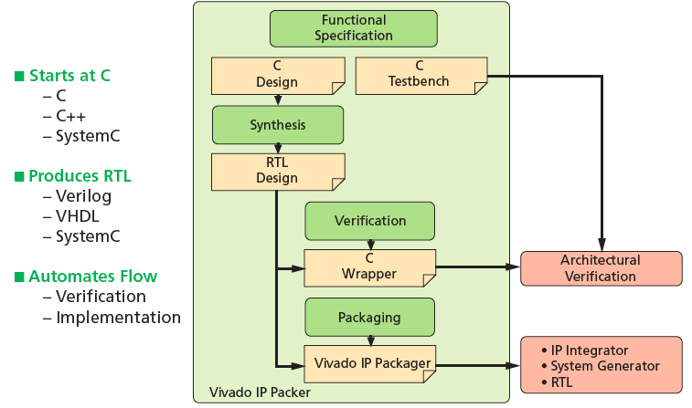
Vivado HLS

Slide 17
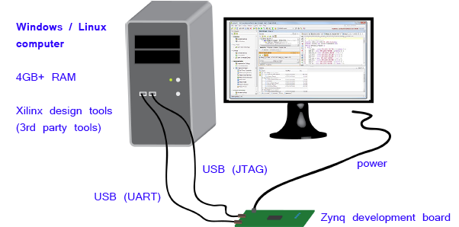
Zynq Development Setup
Source: The Zynq Book

Slide 18
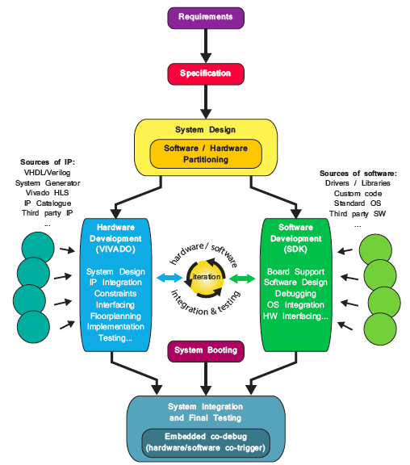
Basic Design Flow for Zynq SoC
Source:
The Zynq Book

Slide 19
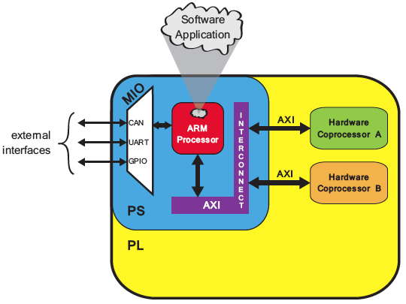
Example Hardware System with MIO
Source: The Zynq Book

Slide 20
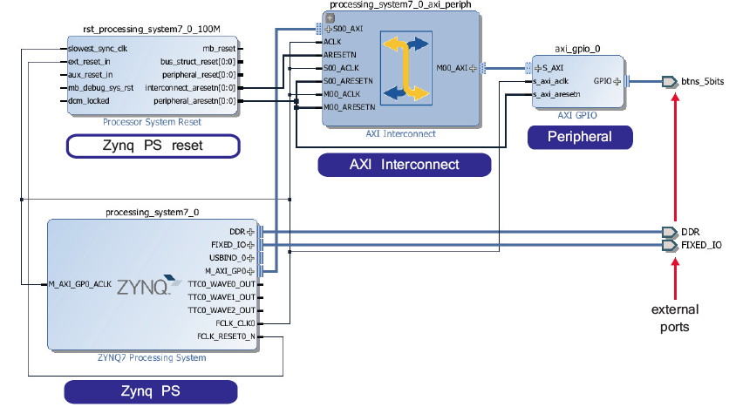
An Example IP Integrator Block Diagram
Source: The Zynq Book

Slide 21
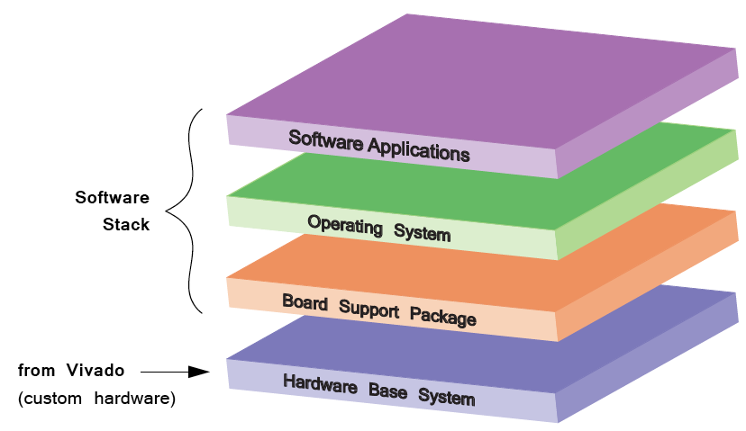
Hardware and Software Layers of a Zynq Design
Source: The Zynq Book

Slide 22
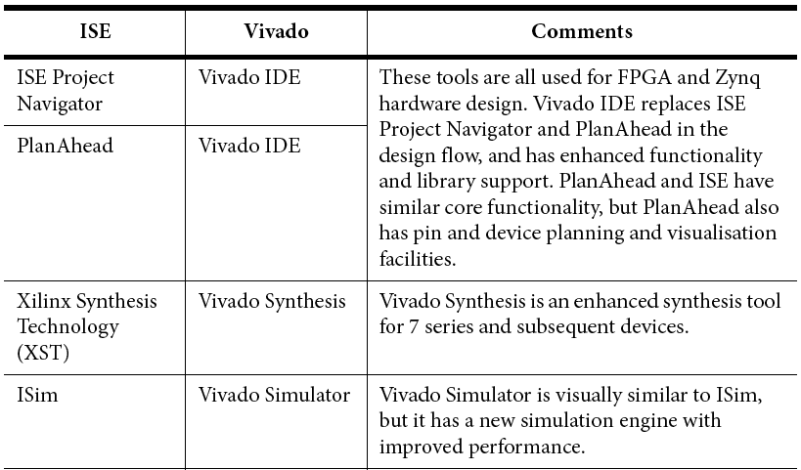
Vivado vs. ISE (1)
Source: The Zynq Book

Slide 23
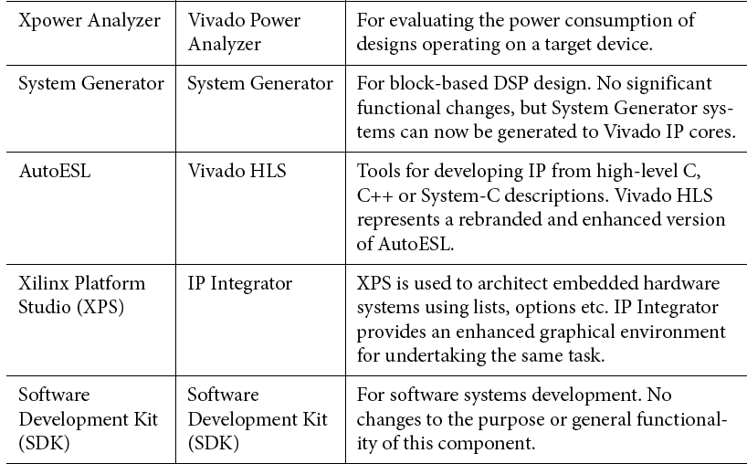
Vivado vs. ISE (2)
Source: The Zynq Book

Slide 24
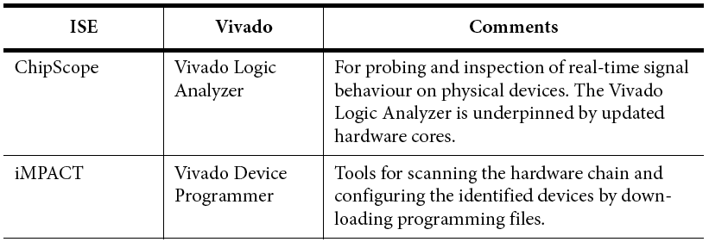
Vivado vs. ISE (3)
Source: The Zynq Book

Slide 25
Support for Xilinx Families
90 nm Spartan-3, Virtex-4
65 nm Virtex-5
45 nm Spartan-6
40 nm Virtex-6
28 nm Artix-7, Kintex-7,
Virtex-7, Zynq 7000
Future families
ISE
Vivado

